Slide 1
Employee Data Analysis using Excel
STUDENT NAME: DURGA DEVI. G
REGISTER NO: 312201491/E7655FE170BCA1A907546C425BC5574B
DEPARTMENT: B.COM (G) COMMERCE
COLLEGE : SRI. SUBRAMANYA SWAMY GOVERNMENT ARTS COLLEGE

Slide 2
PROJECT TITLE
EMPLOYEE ATTENDANCE ANALYSIS USING EXCEL
DATA COLLECTION
ATTENDANCE PERCENTAGE %

Slide 3


AGENDA
Problem Statement
Project Overview
End Users
Our Solution and Proposition
Dataset Description
Modelling Approach
Results and Discussion
Conclusion
3/21/2024 Annual Review

Slide 4

PROBLEM STATEMENT
Data quality issues(missing or incorrect data)
Limited resource(time ,personnel)
Needs for actionable insights and recommendations

Slide 5

PROJECT OVERVIEW
Employee attendance analysis system to track and visualize employee attendance metrics, identify trends and patterns, and provide actionable insights.
Excel dashboard with attendance metrics and visualizations.
Data collection and cleaning.
Better resource allocation and planning.

Slide 6

WHO ARE THE END USERS?
HR Manager
Department Heads
Supervisors
Employees
Management
Payroll and Finance
Operations
Compliance Officer

Slide 7

OUR SOLUTION AND ITS VALUE PROPOSITION
Pivot table
Filtering
Chart and Graphs
Text font
Missing value
Excel formula
Optimize attendance

Slide 8
Dataset Description
EMPLOYEE DATA SET FEATURES :
EMPLOYEES ID
FIRST NAME
LAST NAME
DESIGNATION
MONTH
YEAR
TOTAL DAYS OF MONTH
ALLOWED LEAVE
LEAVE TAKEN
WORKED DAYS
ATTENDANCE PERCENTAGE
CTC
CTC FOR MONTH:

Slide 9

THE "WOW" IN OUR SOLUTION
AUTOMATIC ATTENDANCE
CUSTOMIZABLE DASHBOARD
GEOGRAPHIC MAPPING
Automated Attendance : Integate with HR systems or time-tracking softwarre to automatically update attendance recoords.
Customizable Dashboard : Allow users to create personlized dashboards with relevant metrics and visualizations.
Geograpic Mapping : Visualize attendance data on a map to identify regional trends and patterns.
3/21/2024 Annual Review
9

Slide 10
MODELLING
DATA COLLECTION : Gather attendance data, including employee names,and
Attendance status (Present, Absent, Late, etc.,)
CREATE A TABLE : Organize the data in an Excel table with columns.
PIVOT TABLE : Create a pivot table to summarize attendance data by employee, date, or attendance status.
CHART AND GRAPHS : Visualize attendance trends using charts and graphs.
FILTER AND SORT : Filter data by date, employee, or attendance status, and sort by metrics like absence rate.
10

Slide 11
MODELLING
DATA CLEANING
TECHNIQUES: Pivot table, Filtering, Text font, Chart.
RESULTS

Slide 12
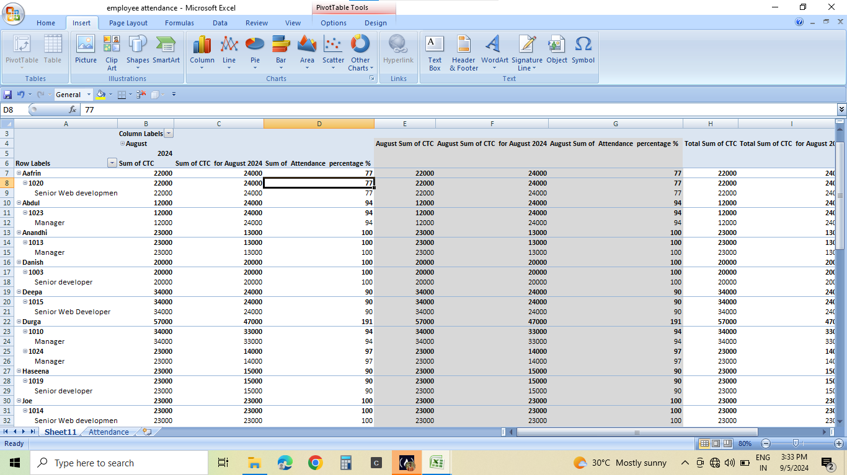
RESULTS
12

Slide 13
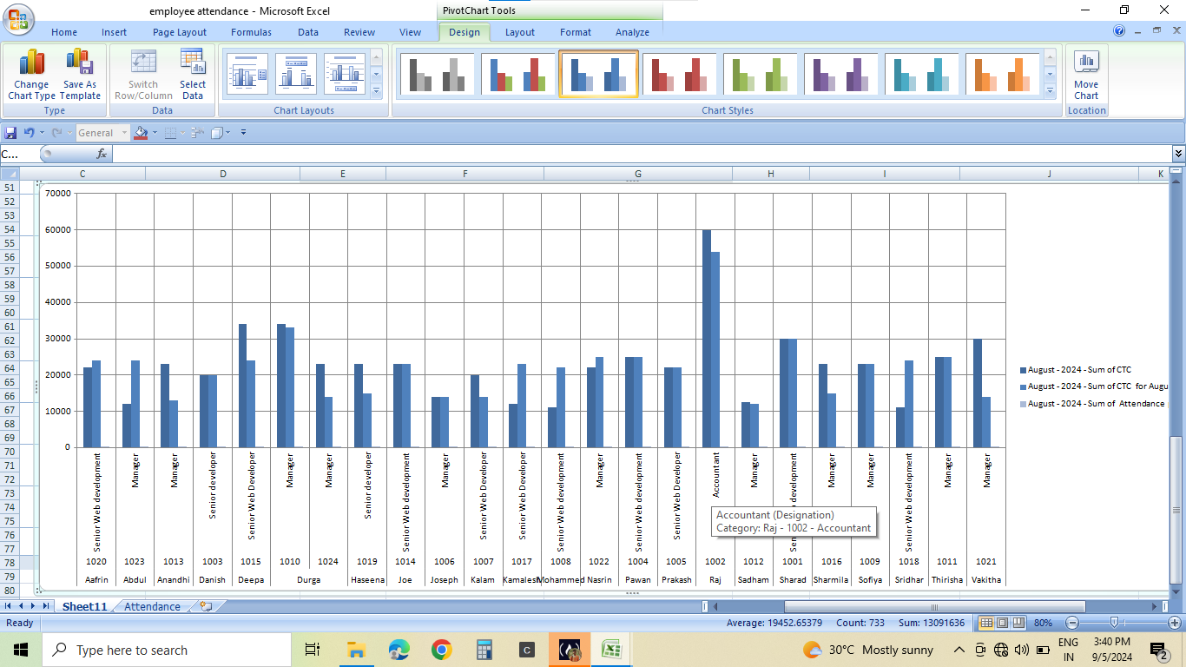

Slide 14
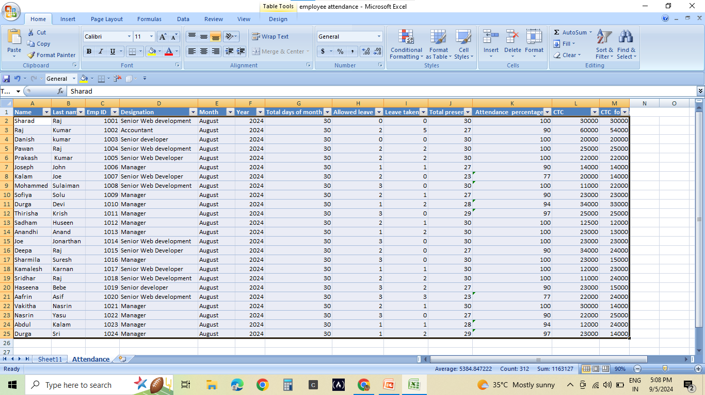

Slide 15
conclusion
Accurately monitor attendance trends and patters.
Identify areas for improvement and optimize attendance policies.
Enhance producitivity and employee engagement.
Reduce absenteeism, tardiness, and turnover.
Make data-driven decisions to drive business success.

